Slide 1
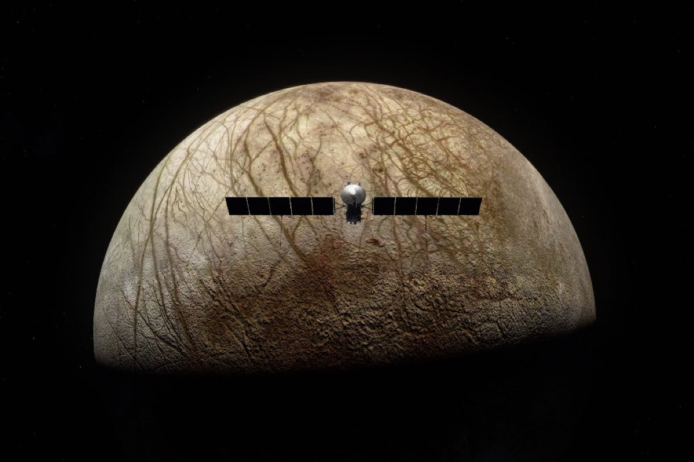
Pilum of Europa
Systems Requirement Report
Michael Frank, Jack Morris, Jakob Schlosser, Thomas Todaro

Slide 2
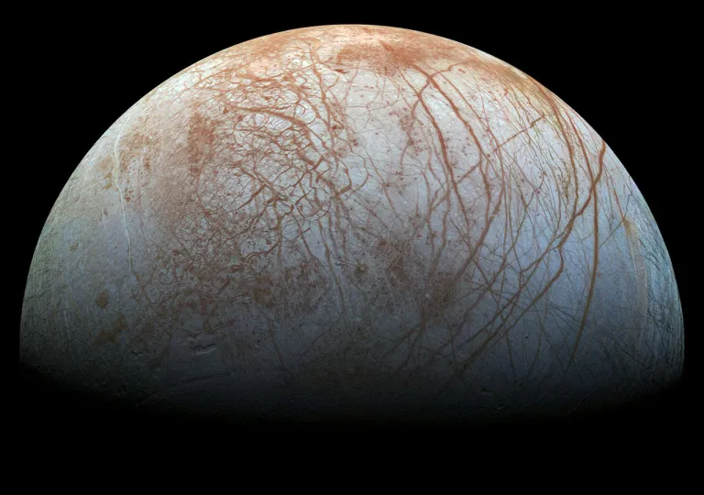
Europa
Europa is the 6th closest moon of Jupiter with an orbital radius of ~671,000 km, period of ~84 hours, and is Jovian-synchronous, meaning, like our moon, the same half of Europa faces Jupiter at all times. Its size is about 90% of our moon's size meaning if gravitational acceleration is only 1.315m/s^2. Its surface is covered in a thick layer, ~15-25 km of ice other than potential water vents that were seen by Hubble to be spewing liquid particulate into the space around it. Europa’s oxygen rich atmosphere and presence of water, even in solid form, open up the possibility of discovering signs of life.

Slide 3
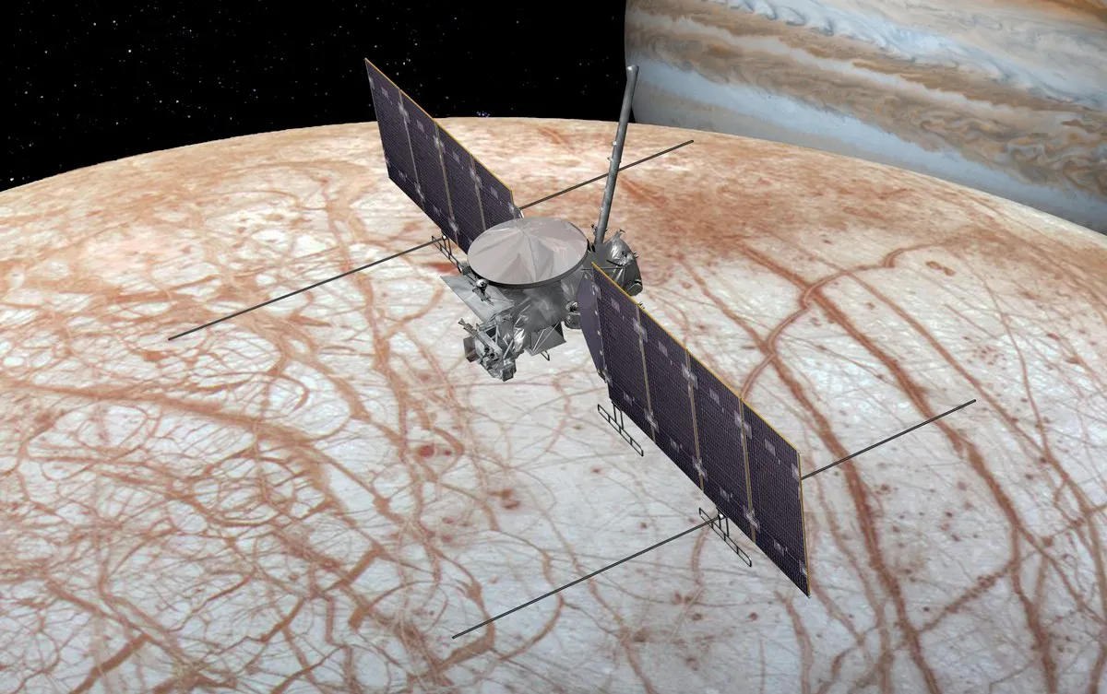
Mission Statement
Our mission would serve as a scientific reconnaissance mission to detect any signs or remnants of life, and also to figure out if there really is an ocean as theorized. If life is determined to have existed then went extinct, we would like to extrapolate potential reasons for the event, such as the radiation emitting from Jupiter.. Judging by the salt water and oxygen gas, we suspect organisms similar to primordial algae exist somewhere in the vast oceans of ice. Our mission would consist of a remotely controlled satellite with the objective of sustaining a low altitude, polar orbit of Europa in order to create a detailed scan of its surface topography, determine potential future landing locations, and to drop a surface contacting probe to drill and analyze surface samples, take atmospheric and temperature data, as well as provide footage of the moon. The spacecraft is also planned to try to intercept one of these plumes of water to analyze the content from orbit, much like Cassini did on Saturn’s moon Enceladus.
Upon completion of the previous directives, we would like to use the satellite as a communications relay to transmit the data from the probe back to earth. This mission will continue until sufficient surface data is recovered and the entirety of Europa is scanned and documented by the satellite. Following this we plan to use our leftover propellant to exit the solar system, photographing and transmitting for the remainder of the satellites life until we lose connection.

Slide 4
Objectives
Primary Objectives:
Achieve a stable, low altitude, polar orbit of Europa for communication relays to Earth.
Deploy a probe to the surface of Europa to transmit surface sample and visual data.
Secondary Objectives:
Leave solar system
Photograph passing bodies
Scout areas for future landings/exploration on Europa
Intercept a water plume in orbit and collect samples from it for analysis
Study radiation waves that come from Jupiter

Slide 5
Preliminary Launch Requirements:
According to the Cosmic Train Schedule and Ames:
Delta V:Earth to Jupiter injection=4.31 km/s
Delta V: Post Jupiter injection=0.91 km/s
Satellite Delta V: Establish Orbit Around Europa=~1.5 km/s
Prove Delta V: Requires 41.268 m/s retrograde burn
C3=Departure Vinf^2= 25.0 km^2/s^2
Potential Schedule:
Proposed launch date 1/27/27
Arrival will take ~4.82 years to Jupiter + at most ~.5 years to get to Europa

Slide 6
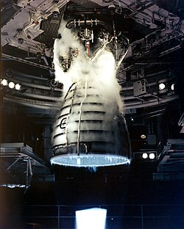
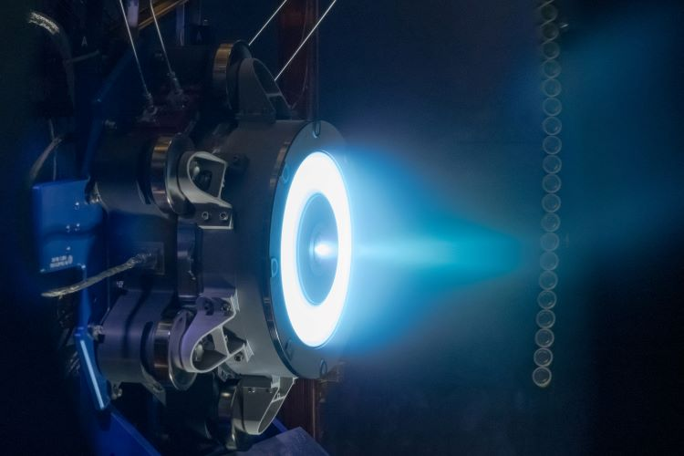
Propulsion
Need high amounts of thrust to leave Earth’s atmosphere and gravitational pull, as well as leave Jupiter’s orbit to get to Europa
Will utilize chemical propellants
Will use ion propulsion for travel across space, is incredibly efficient due to its low speed (takes 4 days to accelerate from 0 to 60 mph)
Leaning towards using Xenon as fuel source
Aerojet Rocketdyne RS-25:
1,859 kN (418,000 lbf) thrust at liftoff
I_sp of 452 seconds (4.43 kN-sec/kg) in a vacuum, or 366 seconds (3.59 kN-sec/kg) at sea level
Mass of approximately 3.5 tonnes (7,700 pounds), and is capable of throttling between 67% and 109%
Hall-effect thruster:
I_sp ≈ 1600 seconds
As of 2009, Hall-effect thrusters ranged in input power levels from 1.35 to 10 kilowatts and had exhaust velocities of 10–50 kilometers per second, with thrust of 40–600 millinewtons and efficiency in the range of 45–60 percent
Nuclear Thermal Propulsion:
I_sp of about 465 seconds, while NTP can achieve almost two times the I_sp of about 900 seconds. In addition to the high I_sp compared to other propulsion systems, NTP has an additional benefit of having a high thrust (10-15 klbf) to weight ratio

Slide 7
Science
In terms of science on and off of Europa, we would like to:
Image the surface of Europa from orbit
Detect radiation
Collect and analyze ice
Log temperature, pressure, and content of the atmosphere

Slide 8
Power, Control, and Communication

Slide 9
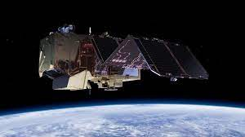
Power
According to Nasa, a typical research satellite can operate comfortably with 200 to 800 watts of solar electrical power. To account for expected electrical heating needs, we will figure about 1.6 kW, meaning:
Power Generation: At the distance from the sun of Jupiter, solar power is only 47.6 W/m^2- to collect 4.67 kw we will need approx~98.04 m^2 of solar arrays. (for reference the Europa clipper use about 90 m^2)
Due to this, we plan to utilize Indium Phosphide solar cells due to their long shelf life as well as implementing an on board nuclear reactor to decrease array weight. The Pilum will also carry its own nuclear reactor due to the fact it will often be obscured from sunlight.
We will likely use Lithium Ion batteries due to their high energy density, efficiency, and low self discharge rate.

Slide 10
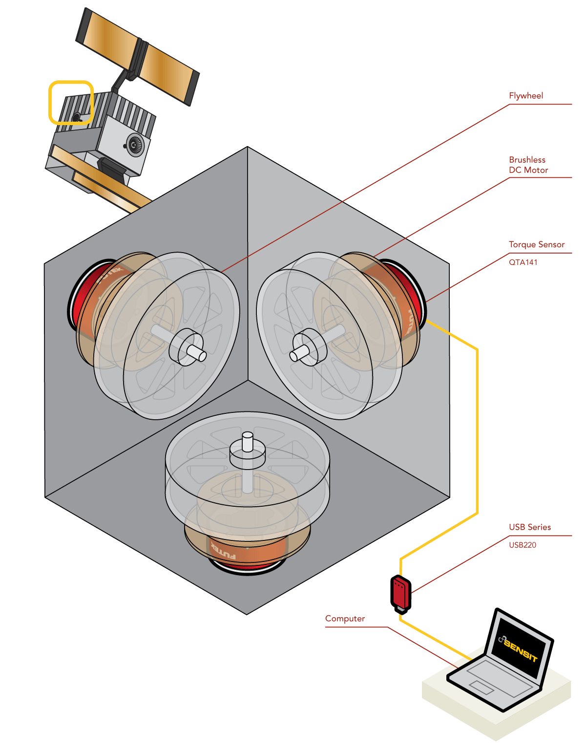
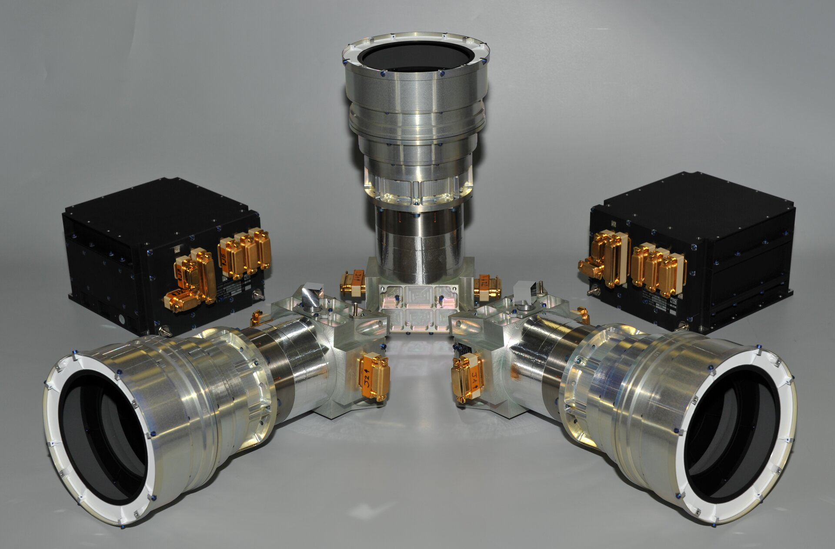
Control
Ion Thruster
High Efficiency, low thrust
Can be used to control attitude in orbit/heighten orbit.
Reaction Wheels
Can also be used to control pointing in orbit, with three axis control.
Star Tracker
Used to find the orientation of the spacecraft relative to constellations and stars.
Guides us to Europa/makes sure our attitude is correct.

Slide 11
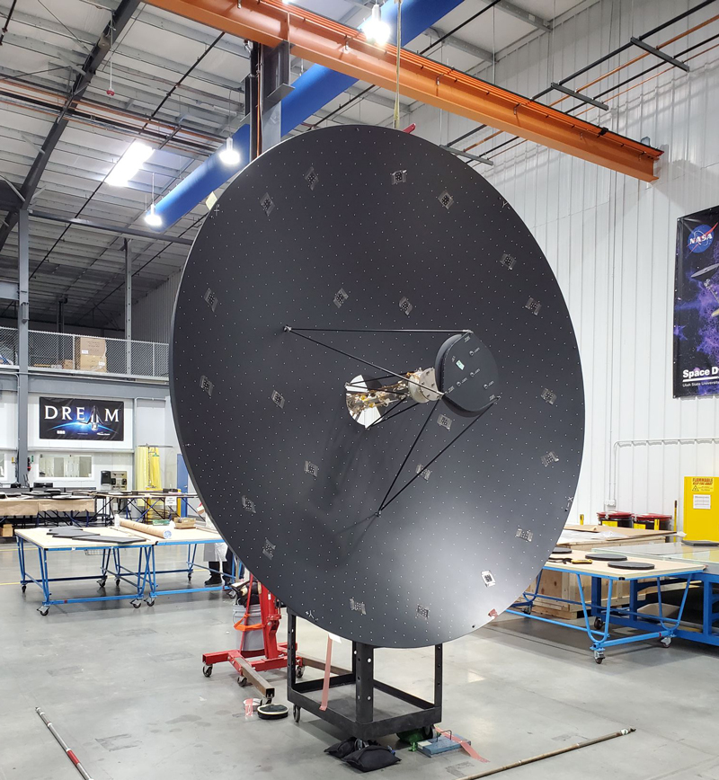
Communication
The satellite will use a X band radio frequency of 8.4 GHz and a Ka band radio frequency of 32 GHz.
Probe will use UHF band radio frequency of 3 GHz.
Frequency Band Selection approved by The National Telecommunications and Information Administration (NTIA).
The modulation technique for both the uplink and downlink will use Quadrature Phase-Shift Keying (QPSK) to support high data rates, the best power efficiency possible, and relatively narrow main lobe width
A roughly 3m High gain to High gain antenna for satellite
Low and high gain antennas on probe.

Slide 12
Launch Vehicle Options

Slide 13
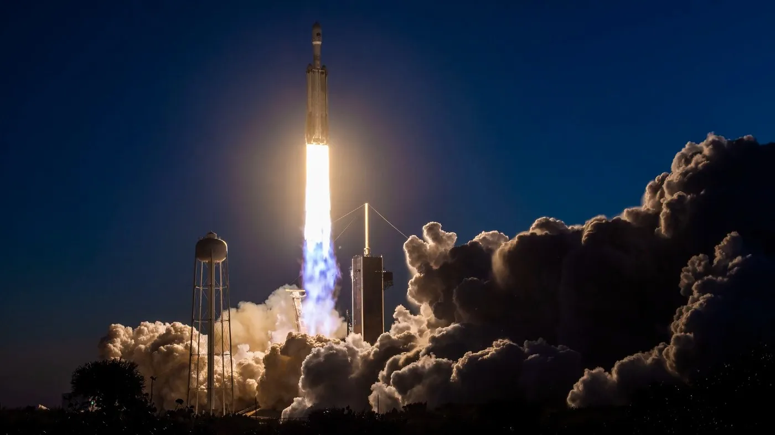
SpaceX Falcon Heavy
The Falcon Heavy has 22.2 MN of total thrust at liftoff in its first stage, and has a wet mass of 1.42 million kg. Dry mass is ~50% of the wet. This launch vehicle is already planned to take a spacecraft to Jupiter, and has a payload of 26761 kg that it can take to deep space.
This booster uses LOX and rocket-grade kerosene as a propellant with a specific impulse at sea level of 300s and 353s in a vacuum. There are two strap-on Falcon 9 like boosters with the heavy booster in the middle for launch.

Slide 14
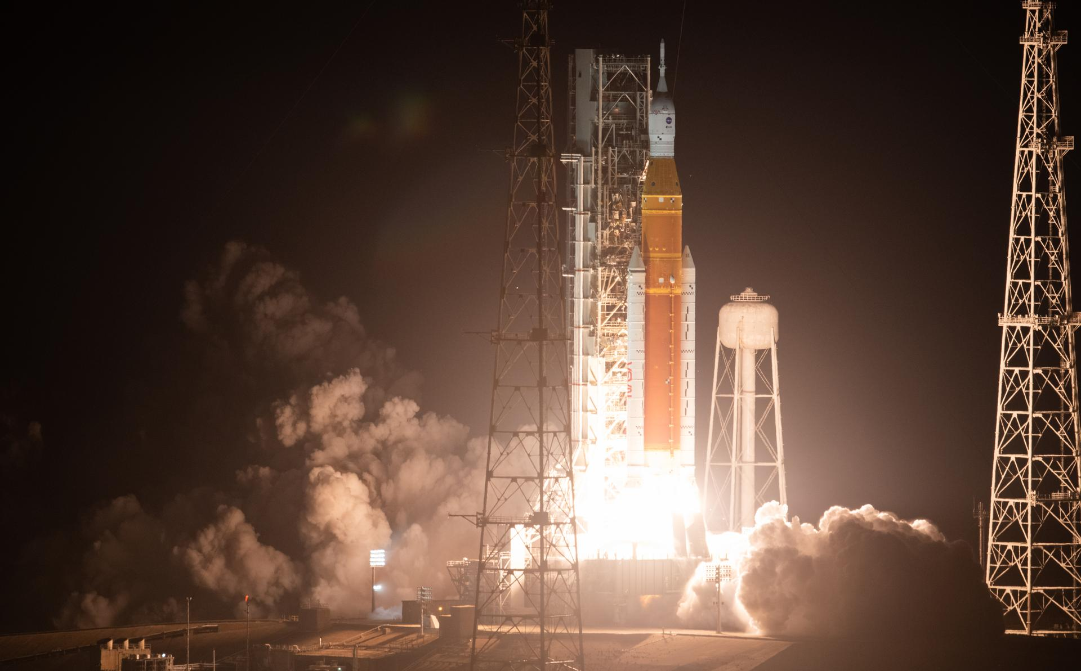
NASA Space Launch System (SLS)
The NASA Space Launch System was designed to take large payloads into deep space and has a maximum launch thrust of 41 MN using block 2 configuration. The launch mass is 2600-2950 metric tons, with the propellant mass about ~50% of that. It can take about 27362 kgs to Jupiter
The SLS vehicle first stage uses 2 strap on solid rocket boosters in the first stage with Polybutadiene acrylonitrile (PBAN) solid propellant, with a specific impulse of 268s, along with a core booster with 4 RS-25D engines with LOX w/ LH2 propellant that has a specific impulse of 451s.

Slide 15
Concepts of Operations

Slide 16
Interplanetary Travel- Getting to Europa
Lift off from launch site, Kennedy Space Center
Circularize orbit at about 300 km altitude
Perform escape trajectory maneuver out of Earth’s SOI
Do a maneuver to increase Sol centered orbit
Potentially use Earth for a gravity assisted maneuver to Jupiter's orbital radius.
Once in close proximity to Jupiter perform transfer to Europa’s Orbital radius about Jupiter
Perform several Jupiter centered orbits at slightly higher altitude than Europa to rendezvous
Once in Europa’s SOI, we will obtain stable orbit

Slide 17

Carrying Satellite “Talos”
Establish stable, low altitude, polar orbit of Europa
Attempt to intercept liquid from surface geysers
Use Pilum as shield and analyzer for plume
Establish communication relay between mission control and Pilum
Deploy Pilum
Begin scan of surface topology

Slide 18
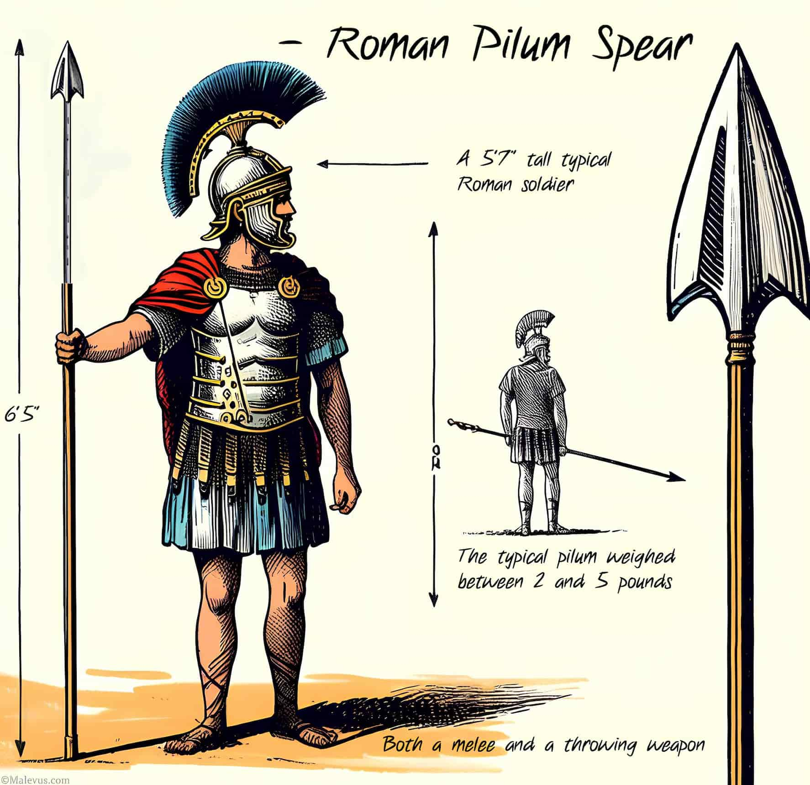
Discovery Drill
”Pilum”
Stay in orbit until a water plume has been intercepted
Analyzes the content of the plume
Deploy from Talos
Small retrograde thrust in Europain orbit ~41.268 m/s Delta V to obtain touchdown trajectory
Detach from thruster and prepare landing gear
Reach surface ice
Use thermally enhanced drill to penetrate
Utilize nuclear heating and electrical power generator

Slide 19
Initial Mass and Power Budgets

Slide 20
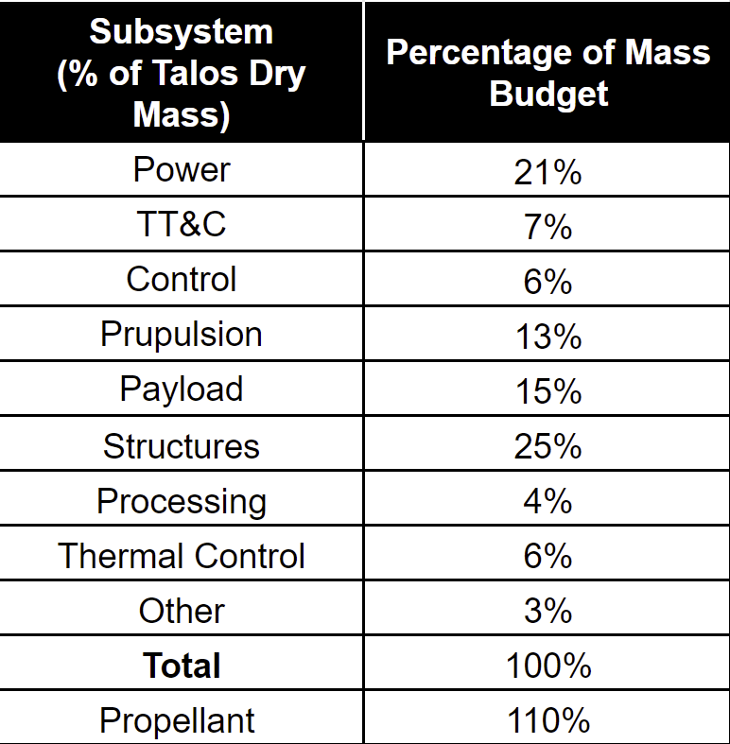
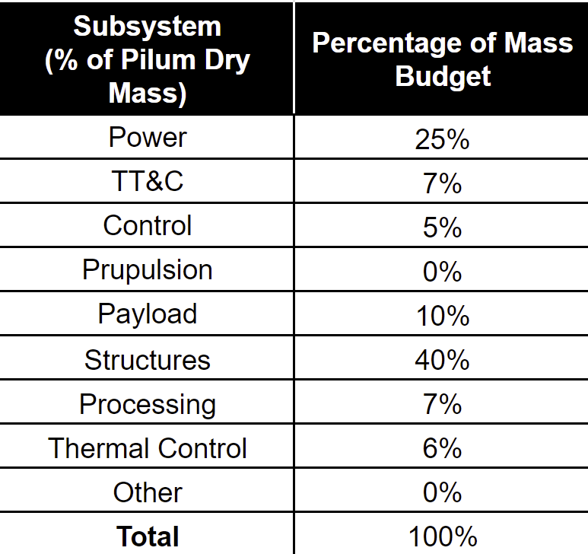
Mass Budget
The following masses and subsequent mass budget are based loosely on the mass of the Europa Clipper and the mass budgets included in the New SMAD textbook used in class.
Estimated dry mass of Pilum (Probe): 1000 kg
Estimated dry mass of Talos (Satellite): 3,500 kg
Estimated wet mass of Talos (Satellite): 7,350 kg
Notes:
According to NASA the approximate weight of the Europa Clipper to be launched in 2024 is around 13,000 lbs or 6,000 kgs.
Approximately half of this weight is dedicated to fuel.
Exact Numbers: Dry mass = 7,145 lbs (3,241 kg)
Launch mass = 13,371 lb (6,065 kg)
Payload mass = 776 lb (352 kg)

Slide 21
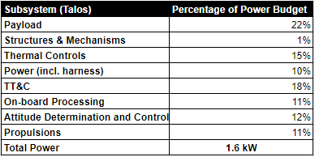
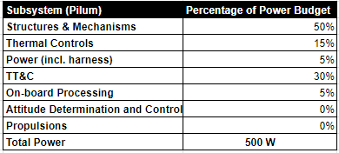
Power Budget
Power usage will be different depending on stage of operation. During the Earth to Earth and Earth to Jupiter maneuvers, more power may be dedicated to propulsion and controls to ensure arrival, however, once at Europa, more power will be dedicated to TT&C, payload science, ect.
For the Pilum, large amount of power will be dedicated to moving, collecting, and transmitting data back to Talos. Movement will likely be linked to mechanisms.

